Slide 1

Installing PowerBI
CGI Federal, Lafayette Office

Slide 2

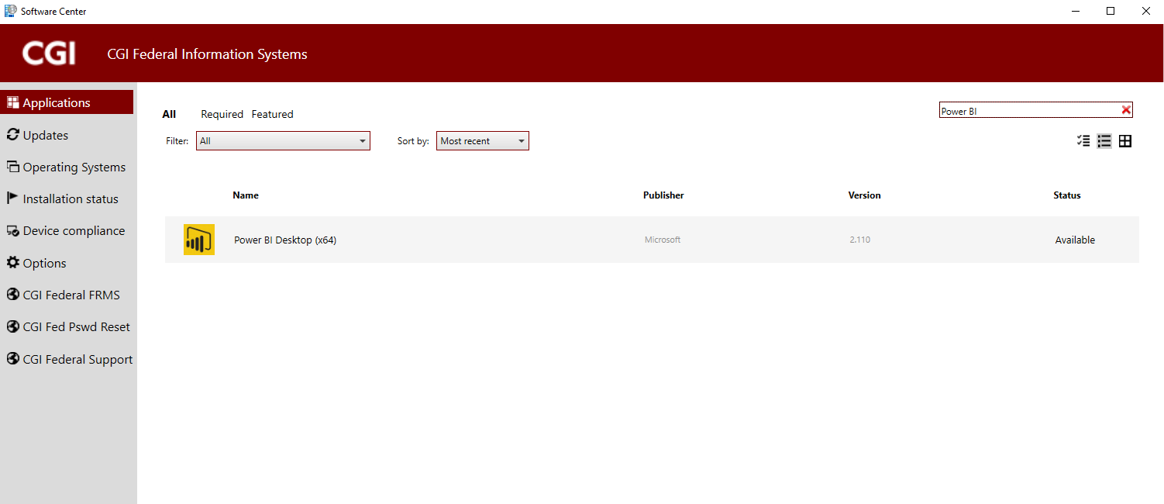
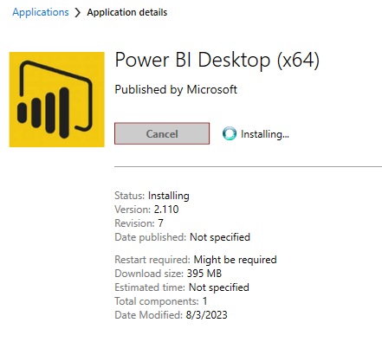
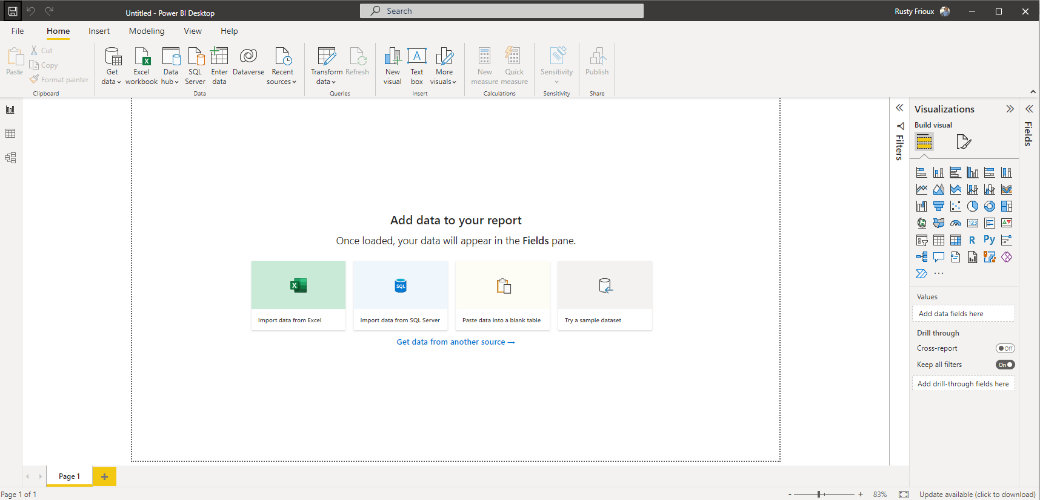
Step 1: Install the Power BI desktop
On your CGI Federal laptop,select the search icon, then type “Software Center.”
From the Software Center, find and download “Power BI Desktop x64.”
Select “Install.” You do not need to call the CGI Helpdesk for this!
You may need to restart your computer.
When you restart your computer, PowerBI will be available.

Slide 3
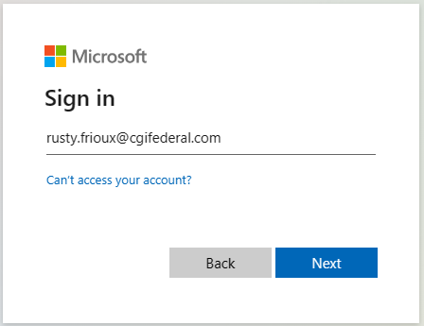
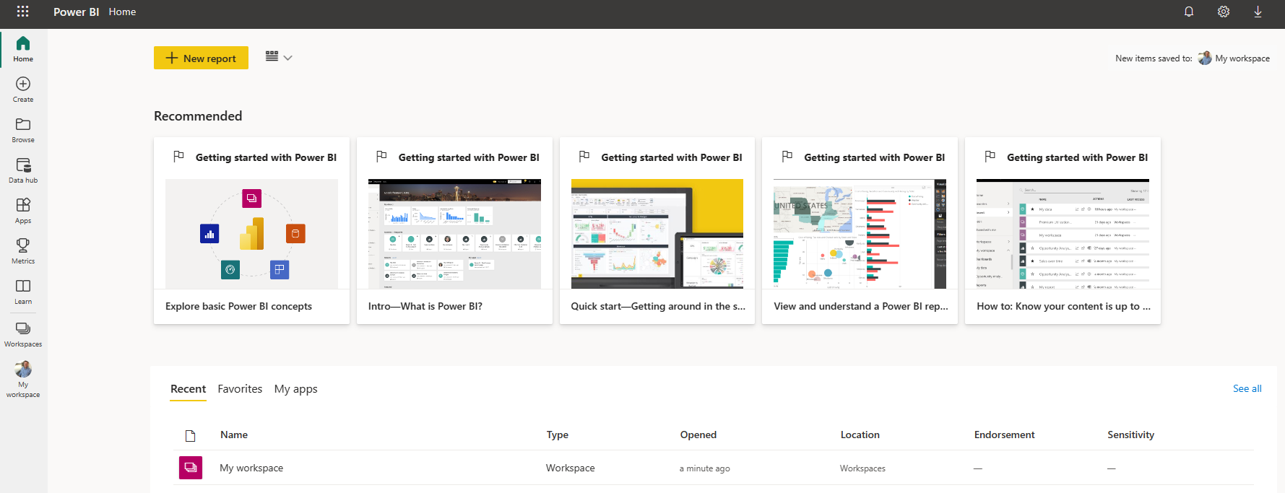
Step 2: Log into the PowerBI Service
On your CGI Federal laptop, open Edge or Chrome and navigate to https://app.powerbigov.us/.
    Note: Because of our Federal work, CGI uses Microsoft’s government edition of PowerBI. The commercial link will not work for your CGI account
Sign in with your CGI Federal email address, e.g. “rusty.frioux@cgifederal.com. The first time you log in you may see a slightly different login dialogue than the one at the right.
Once you’re in, you should have access to “My Workspace,” along with several training resources. CGI Federal provides all of us access to a PowerBI Pro license.
During our training session we will use both tools – the Desktop and the PowerBI Service.
https://app.powerbigov.us/.

